Slide 1
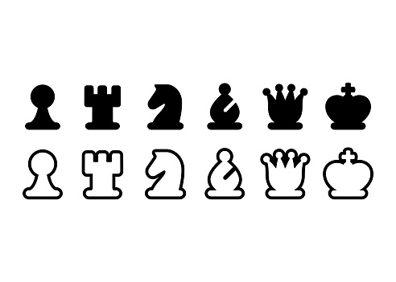
Chess Simulator
2016310703 남득윤

Slide 2

Introduction
After I watch Netflix “The Queen's gambit” I felt so much interest in chess.
I learn many thing about JAVA as well as some tips for programming on board game
In this project, I will develop my own Chess Simulator
Netflix “The Queen’s Gambit”

Slide 3
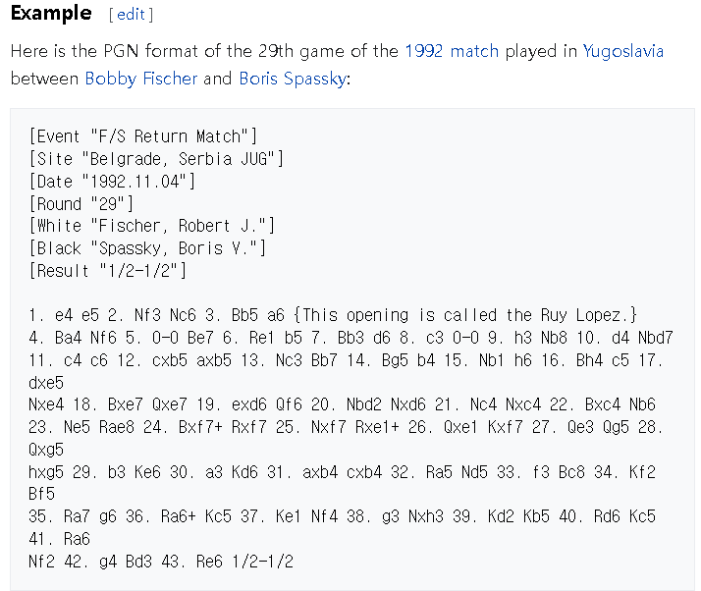
Pgn is a notation for chess game. It contains the match information and the move orders
PGN – potable game notation
Pgn example capture from wikipidia

Slide 4
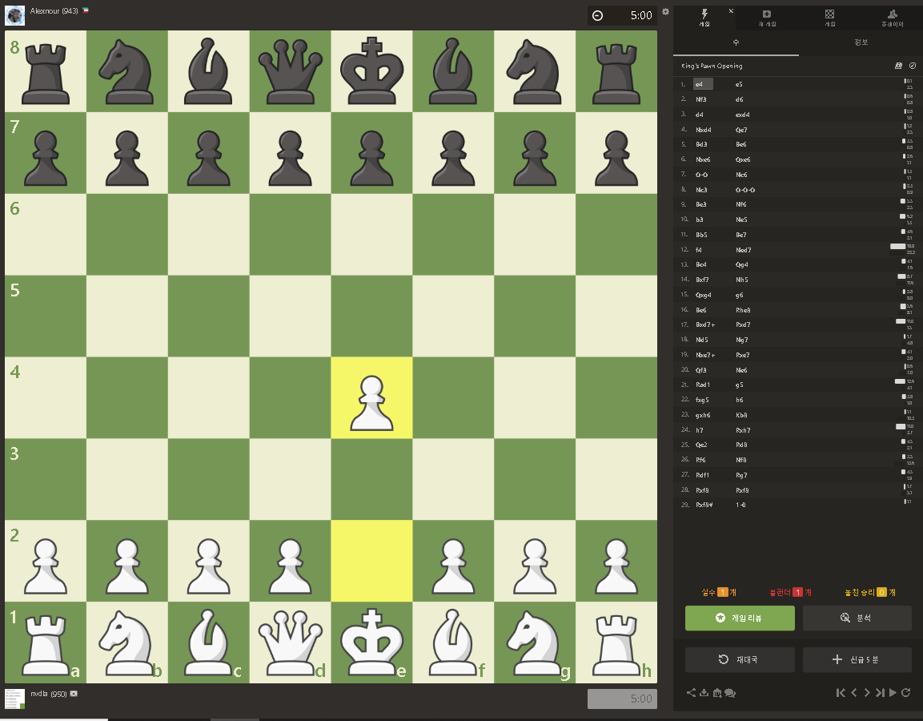
Goals - requirement
Develop a pgn viewer that can simulate an ended chess game.
Consider only valid pgn files of Chess.com.
That is there are no invalid move.
Chess.com is one of most favorite chess web site.
Set white down-side.
Consider special moves (EnPassant, Promotion, Castling)
Simulate chess with gui
Load game
Next move
Chess.com

Slide 5
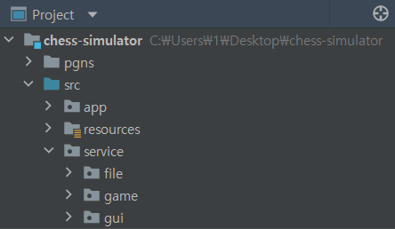
Project Structure

Slide 6
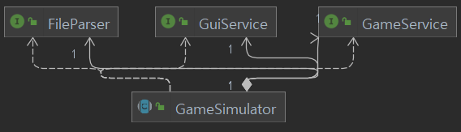
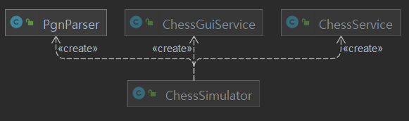
Abstraction/Class Diagram

Slide 7
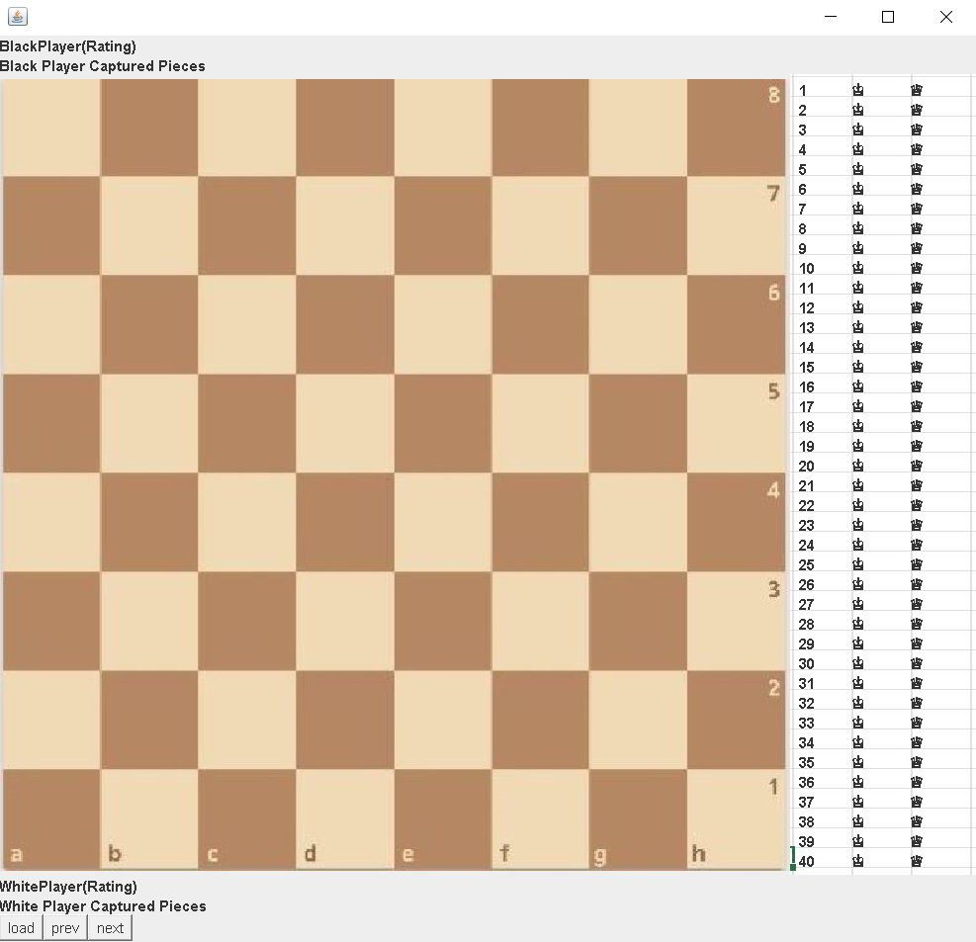
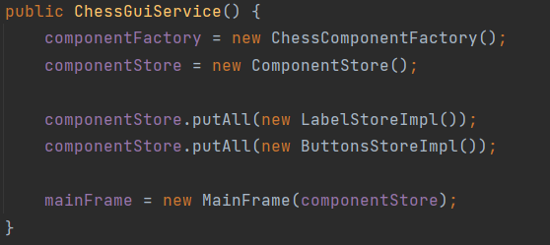
GUI
All Components in GUI :
6 Labels and 3 Buttons

Slide 8
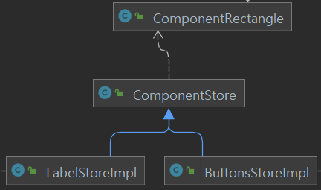
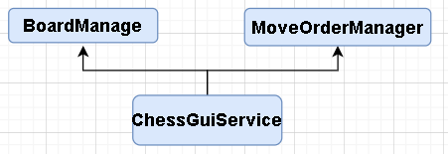
GUI – in detail
work together classes in initializing stage
Work together classes in nextButton

Slide 9
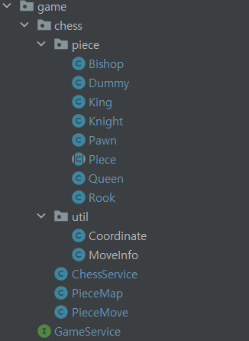
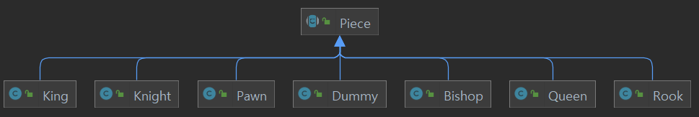
Game

Slide 10
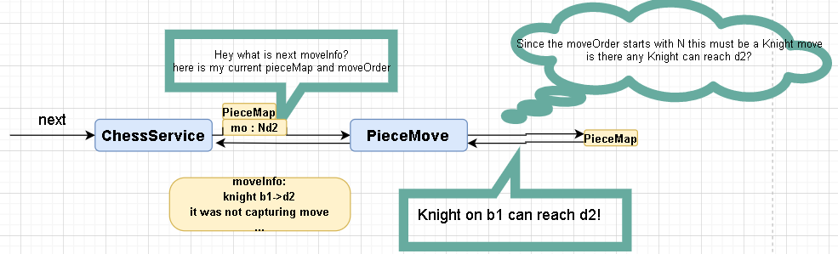
Game in detail

Slide 11
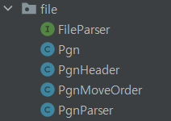
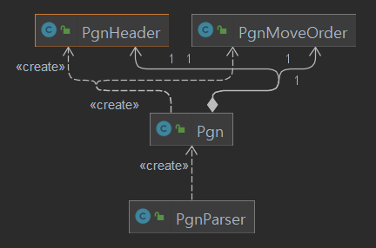
File

Slide 12
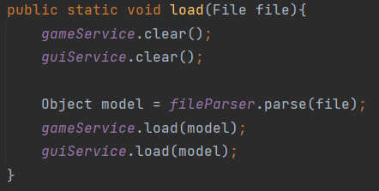
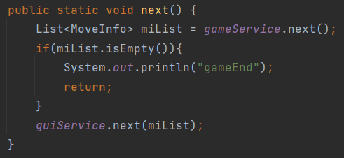
App
Load button -> GamSimulator.load
Next button -> GameSimulator.next

Slide 13
Not Implemented
Validation on next move, loaded file
Prev Move, Captured Piece display, Highlightning moved square
Play Chess, Board Flip, AI adopted
Can be updated
In dreams

Slide 14
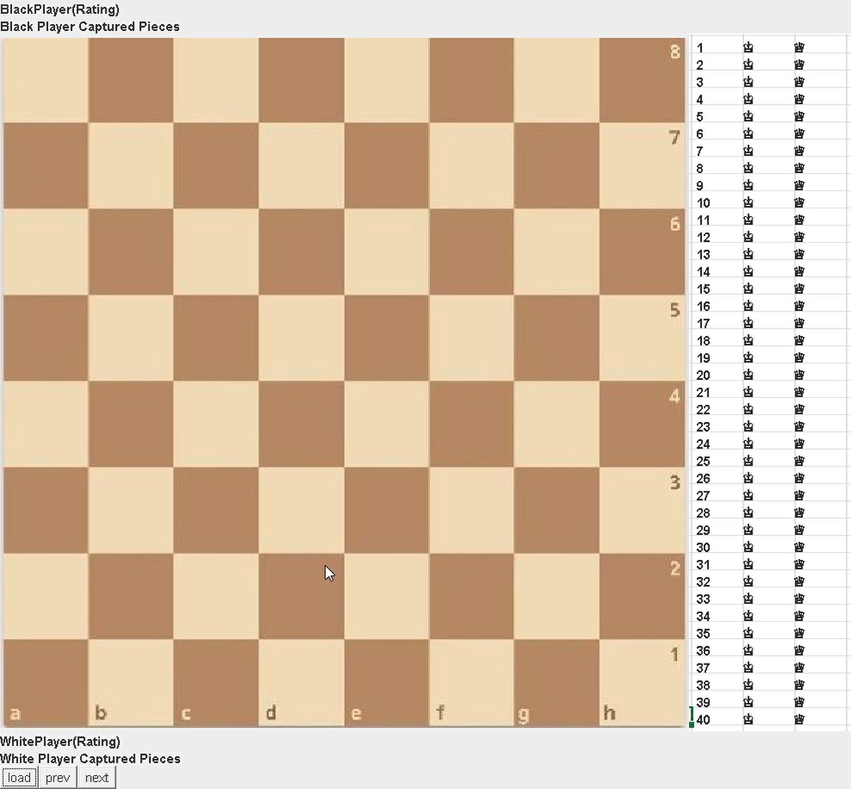
Demo Video

